Slide 1
Group 13: AMR Coursework 3
Feedback Control - 10535496

Slide 2
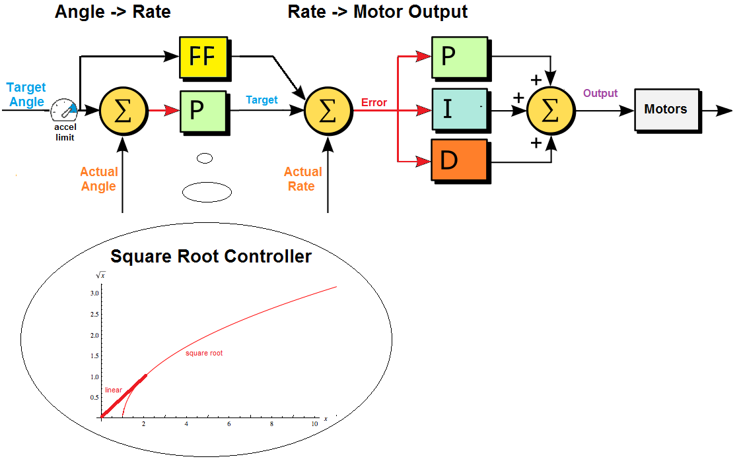
Autotuning PID: What is a PID
Simple – Only 3 control terms
Proportional
Derivative
Integral
Must be tuned
Highly adaptable
Credit: Ardupilot, 2024[1]
Notes:
Light weight
Angular rate controller
Reliable and robust control with minimal work and tuning

Slide 3
Why a PD Controller?
Integral windup
Simplified control loop
No source of steady state error

Slide 4
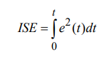
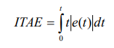
Autotuning PD: how does it work?
Modify gains to improve system performance
ISE
Punishes large transient errors used to tune Proportional gains
ITAE
Larger losses for consistent errors and oscillation, used to tune Derivative gains[2]
Notes:
For our controller we used
ISE and ITAE loss functions

Slide 5
Updating gains
Small gain updates ~2%
Updates gains based on extended history
Gains are changed by a fixed factor in either direction
Notes:
If the system diverges it is unrecoverable
Updates in gains are conservative
Once the gains are found they are ‘locked in’

Slide 6
How well does it work? Simulation
Video

Slide 7
Does it work? Simulation.
Notes:
Gains are automatically updated

Slide 8
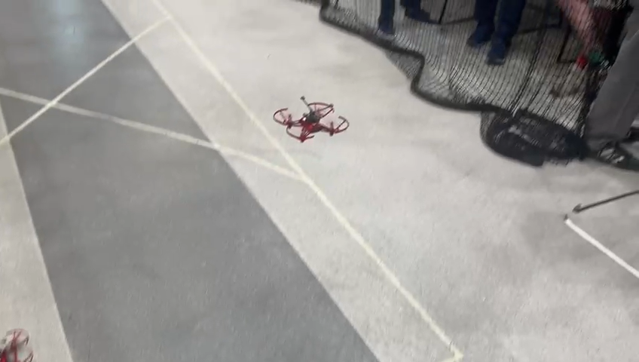
Does it actually work?
Notes:
Smooth operation
No overshoot
Critically damped
Minor instability in yaw
Initial tuning from simulation

Slide 9
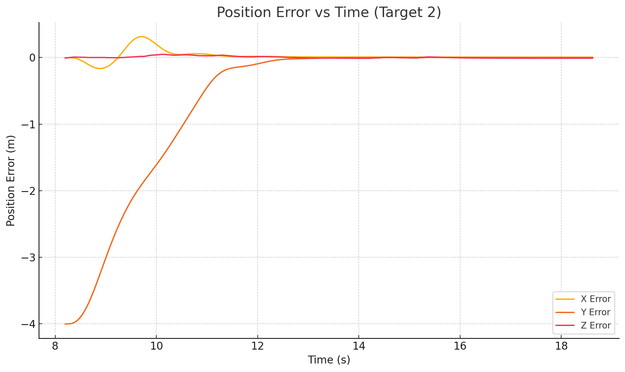
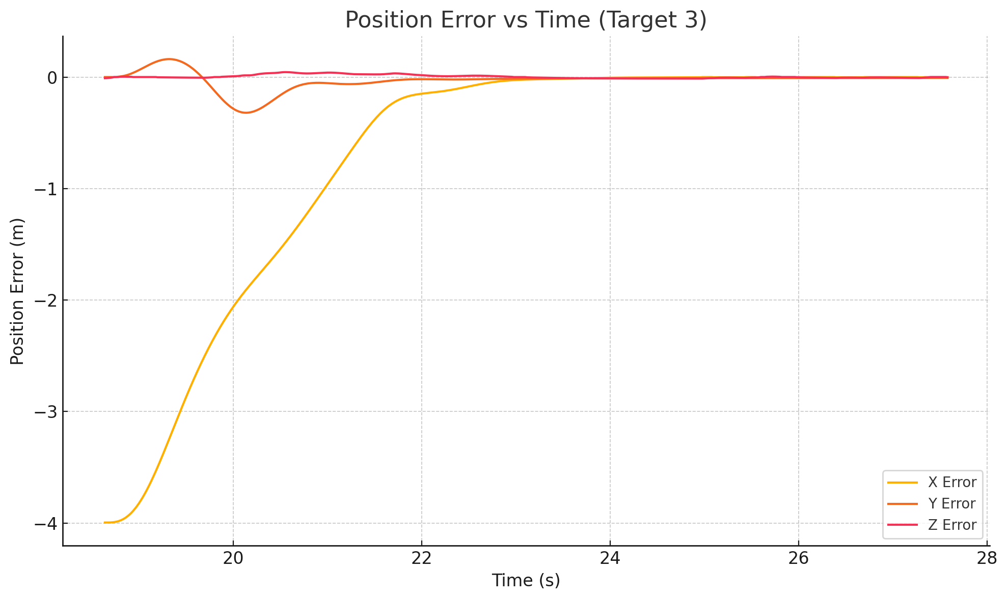
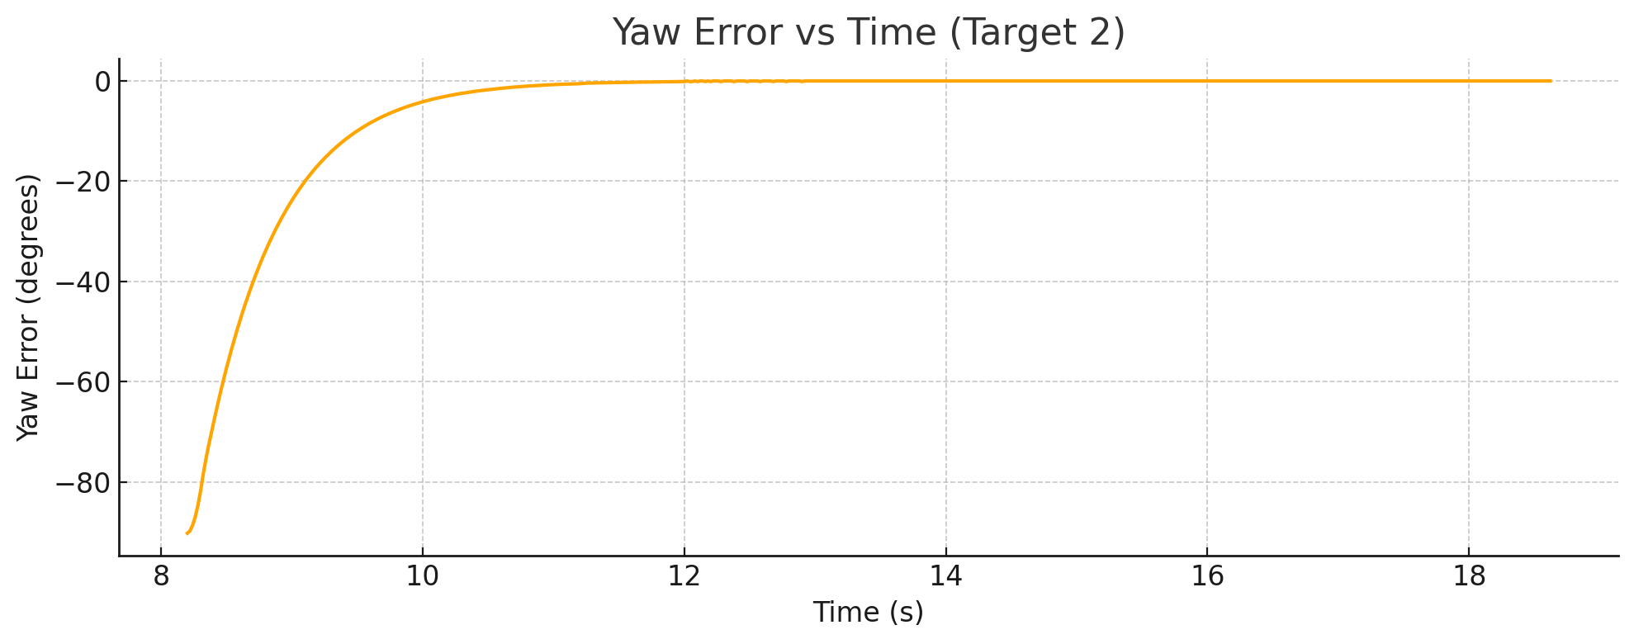
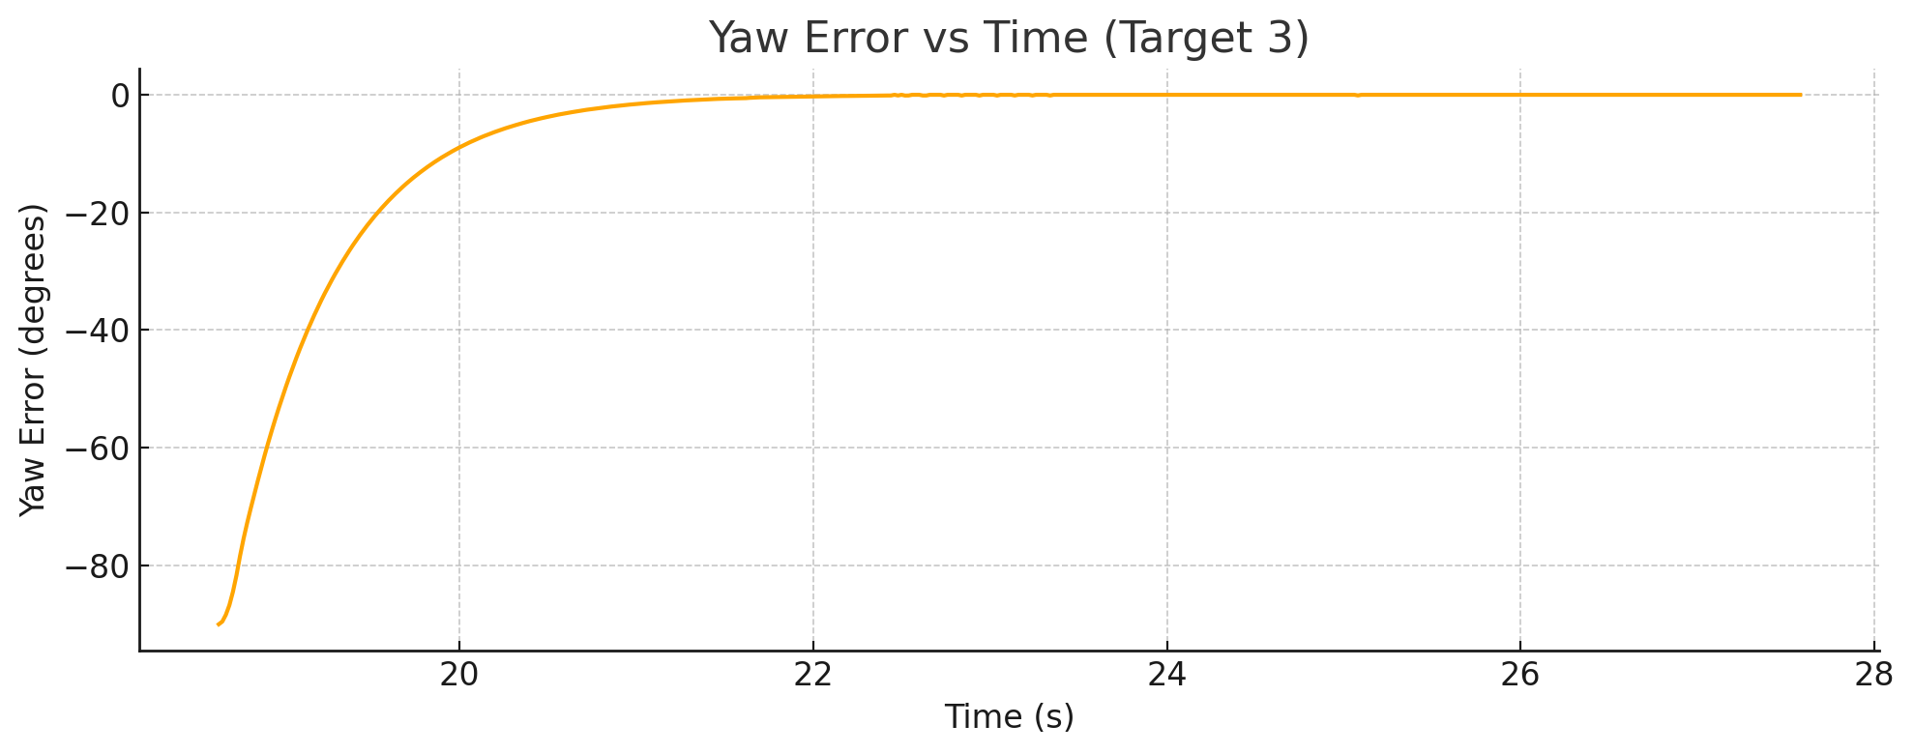
Does it actually work?
Plots of data
Notes:
Under tuning in Yaw
Slight over tuning in Kp_x likely due to separation of lateral gains
Could be improved by using and proportional gains in x and y axes
Reaches the target point in less than 15 seconds

Slide 10
Limitations
Good training data
Movement in one axis can cause over tuning in other axes
Does not guarantee good performance

Slide 11
Conclusions & Discussion
Suitable use case
Care needed in tuning
Gain freeze once tuned

Slide 12
References
[1]https://ardupilot.org/dev/docs/apmcopter-programming-attitude-control-2.html
[2]https://www.scientificbulletin.upb.ro/rev_docs_arhiva/full0e5_577239.pdf

